Slide 1
Management of Training & jobs Service

Slide 2
Goals
Enabling students to get training in the best companies
Enabling companies to train students
Enabling universities to implement their study plans by facilitating the training of their application
A chance to Provide jobs after training or graduation

Slide 3
Overviews
the students suffered to find a training
also the companies are unable to reach students
And the inability of the universities to check the students in the training stage
and that give us the idea of a system where students can put their cv and advertise themselves
Companies can also access the site and communicate with the student who applied for training

Slide 4
System Conception
Who is the application for?
What problems will it solve?
Why is it needed?
Where will it be used?
How will it work?
When is it needed?

Slide 5
Who is the application for?
For the students who still in the university or they graduate and looking for a training and courses to get experience in the best companies. And for the universities and companies also.

Slide 6
What problems will it solve?
The biggest problems that will get solved is that this project:
Gives the advantage of not needing to go to the companies to apply for a certain courses and jobs it will save a good amount of time and effort for students and companies and universities.
As a student you will gain experience before you start working with a huge companies
It will help the student knowledge about the requirement of labor market.

Slide 7
Why is it needed?
It will save a decent amount of time and effort for students when it comes to looking for jobs and courses, alongside meeting a lot of people with a lot of experience they could share with the freshly graduated or current students companies can look for qualified candidate to work with them.

Slide 8
Where will it be used?
This web application can be used by freshly graduated students or current students on Google Chrome or Microsoft Edge

Slide 9
How will it work?
The Companies will be able to see student’s information and their CV’s.
Students can apply for training in the elite companies and they could upload their CV’s and information on the website .
Universities give priorities to students applied for training through our website and universities are mediators between students and companies.

Slide 10
When is it needed?
It is needed when a student needs to apply for a training and students will be able to gain experience before applying for jobs.
The project will be considered done on the 5th of February approximately.

Slide 11
Application Analysis
Introduction about application analysis
Functional requirement
Non-Functional requirement
Use Case Diagram
Use Case Requirements Specification

Slide 12
Introduction about application analysis
Requirement is a condition or capability possessed by the software or system component in order to solve a real-world problem. The problems can be to automate a part of a system, to correct shortcomings of an existing system, to control a device, and so on. IEEE defines requirement as a condition or capability needed by a user to solve a problem or achieve an objective. A condition or capability that must be met or possessed by a system or system component to satisfy a contract, standard, specification, or other formally imposed documents. Requirements describe how a system should act, appear or perform. For this, when users request for software, they provide an approximation of what the new system should be capable of doing. Requirements differ from one user to another and from one business process to another.

Slide 13
Introduction about application analysis
Different Types of Software Requirements:
Functional Requirements.
Non-Functional Requirements.
Find Actors:
Student
Company
University
Admin

Slide 14
Functional requirement
Register: the admin can registrant the new student or company and university
Login: the Students, admin, university and Company can use their username and password to log in to the website
Logout: the Students, admin, University and Company can logout from the website using a button.
Apply for training: The Student after Signing in will fill the form he needs
View Details: the Students, admin, university and Company can view all the information in the forms.
View Submitted Form: The Company, admin can view the forms that students applied for.

Slide 15
Non-Functional requirement
Performance: defines how fast a software system or its particular piece responds to certain users’ actions under certain workload.
Based on response time which is less than 7 seconds.
Authorization: is a non-functional requirement, which relates to how system functionality works between the actors (admin, university, company, students)
Based on testing different logged in accounts

Slide 16
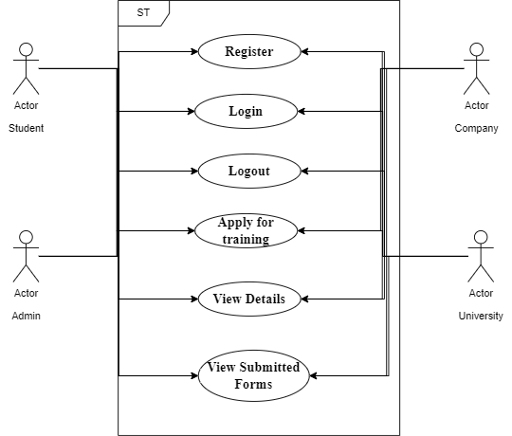
Use Case Diagram

Slide 17
Use Case Requirements Specification
Overview
Title | Register
Description | the admin can registrant the new student or company
Actor | Student, Company, University ,admin
Initial Status | None
Basic Flow
Step1: Enter the URL of the website. Step2: Click on Registration in login page, then fill the forms of step 1 and step 2. Step3: Click Create.
Post Condition
After clicking create you can login.
Alternative Flow
None

Slide 18
Use Case Requirements Specification
Overview
Title | Login
Description | Use username and password to enter the website
Actor | Student, Company, University ,admin
Initial Status | None
Basic Flow
Step1: Enter the URL of the website. Step2: Enter username and password. Step3: Click login. Step4: The portal will open
Post Condition
After clicking login the portal will open.
Alternative Flow
In Step 3 when you enter an invalid password an alert will appear.

Slide 19
Use Case Requirements Specification
Overview
Title | Logout
Description | Use to exit the portal in the website
Actor | Student, Company, University ,admin
Initial Status | Logged in
Basic Flow
Step1: Click the logout button at the top of the website. Step2: The portal will be closed.
Post Condition
After clicking logout the portal will close.
Alternative Flow
None.

Slide 20
Use Case Requirements Specification
Overview
Title | Apply for training
Description | The Student after he Signed in, he will fill the form needed
Actor | Student
Initial Status | Logged in
Basic Flow
Step1: Log in. Step2: Choose the form needed to fill. Step3: After filling the form click submit. Step4: Notification will appear
Post Condition
N/A
Alternative Flow
N/A

Slide 21
Use Case Requirements Specification
Overview
Title | View Details
Description | The Student, Companies and University and admin can view form details
Actor | Student, Companies, admin, university
Initial Status | Logged in
Basic Flow
Step1: Log in. Step2: Click details beside your forms to view details.
Post Condition
After clicking details the form information’s will appear
Alternative Flow
None.

Slide 22
System Architecture
What is your software Architecture?
Why did you choose it?
Description of your software Architecture

Slide 23
What is your software Architecture?
The software architecture is MVC: Model View Controller

Slide 24
Why did you choose it?
The actual purpose of MVC is to separate your views from your controller and model. In other words, it is a design pattern is a structure for keeping display and data separate to allow each to change without affecting the other. By saying so, it is mostly used for GUI stuff.
You should use an architecture that separates logic from your views. If needed, you should use an architecture that utilizes a controller (such as MVC) if there is logic required that doesn't necessarily fit into a model

Slide 25
Description of your software Architecture
Model
The model component stores data and its related logic. It represents data that is being transferred between controller components or any other related business logic. For example, a Controller object will retrieve the customer info from the database. It manipulates data and sends back to the database or uses it to render the same data.
It responds to the request from the views and also responds to instructions from the controller to update itself. It is also the lowest level of the pattern which is responsible for maintaining data.
Model, contain classes and within those classes are data stored in them. and the models we used in the project : (users),(company),(university),(usertype),(CodeUnivesity),(transaction),(Code nationality),(Courses),(Student master),(Code Company)

Slide 26
Description of your software Architecture
View
A View is that part of the application that represents the presentation of data.
Views are created by the data collected from the model data. A view requests the model to give information so that it resents the output presentation to the user.
The view also represents the data from charts, diagrams, and tables. For example, any customer view will include all the UI components like text boxes, drop downs.
The view will show the page in the website and the views we used in the project: (users),(company),(university),(usertype),(CodeUnivesity),(transaction),(Code nationality),(Courses),(Student master),(Code Company)

Slide 27
Description of your software Architecture
Controller
The Controller is that part of the application that handles the user interaction. The controller interprets the mouse and keyboard inputs from the user, informing model and the view to change as appropriate.
A Controller send’s commands to the model to update its state (E.g., Saving a specific document). The controller also sends commands to its associated view to change the view’s presentation (For example scrolling a particular document).
The controller is the part where we use the backend where we use methods to create or delete or edit and here is some of the controllers we used in the project:
(users),(company),(university),(usertype),(CodeUnivesity),(transaction),
(Code nationality) ,(Courses),(Student master),(Code Company)

Slide 28
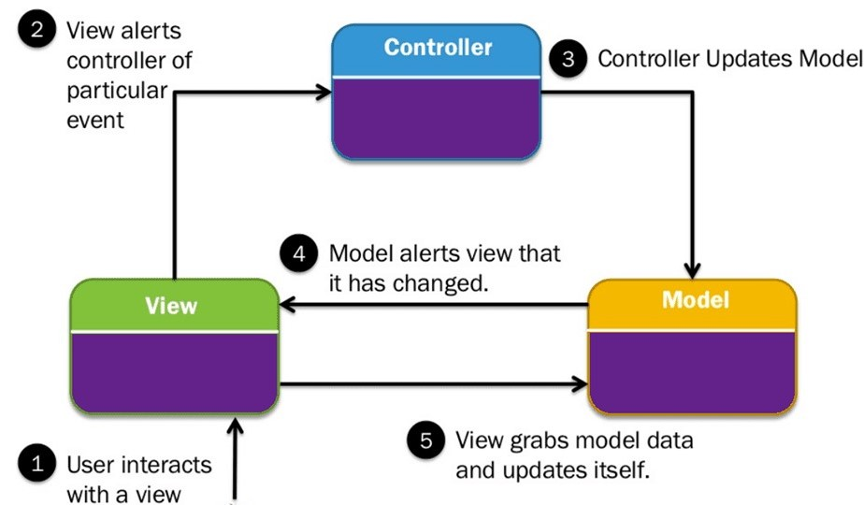
Description of your software Architecture

Slide 29
System Design
Class diagram
Relational Database Table
User Interface Design

Slide 30
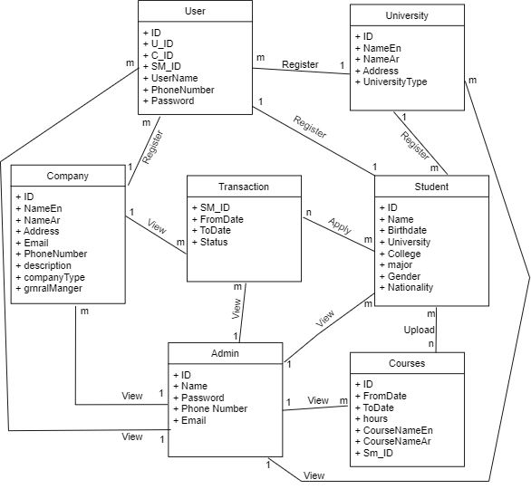
Class diagram

Slide 31
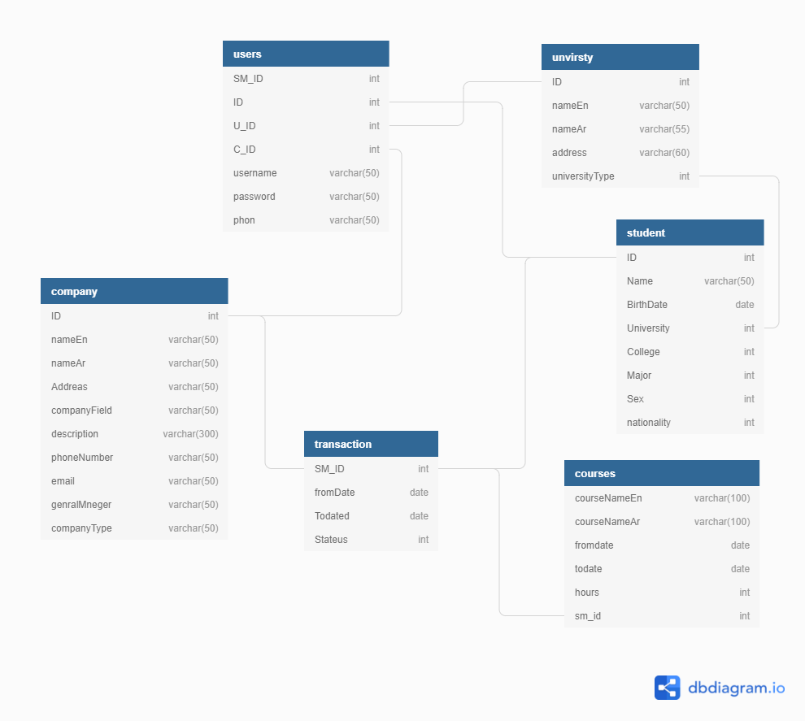
Relational Database Table

Slide 32
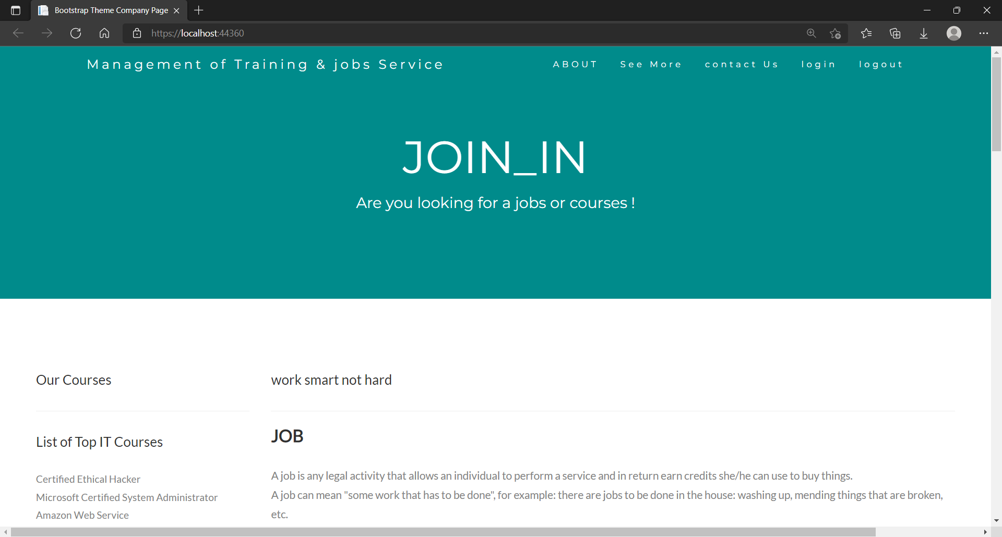
User Interface Design (Home Page)

Slide 33
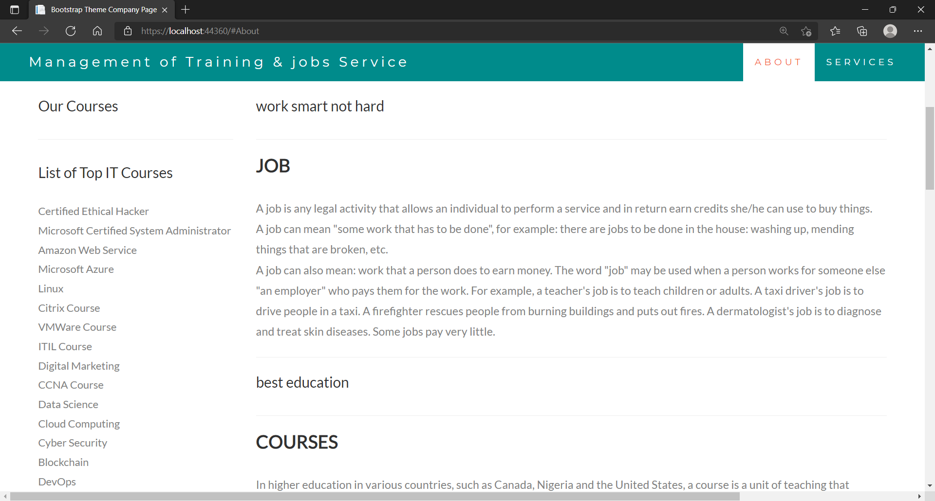
User Interface Design (About Page)

Slide 34
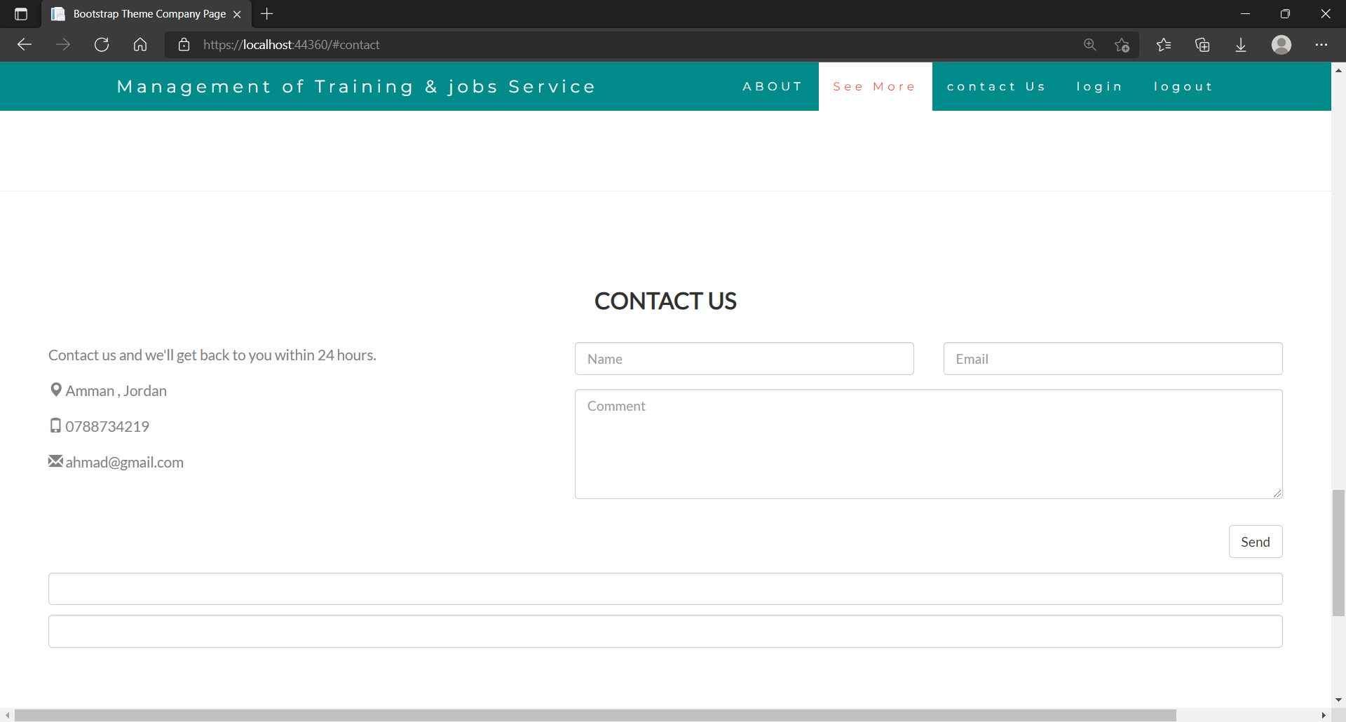
User Interface Design (contact us Page)

Slide 35
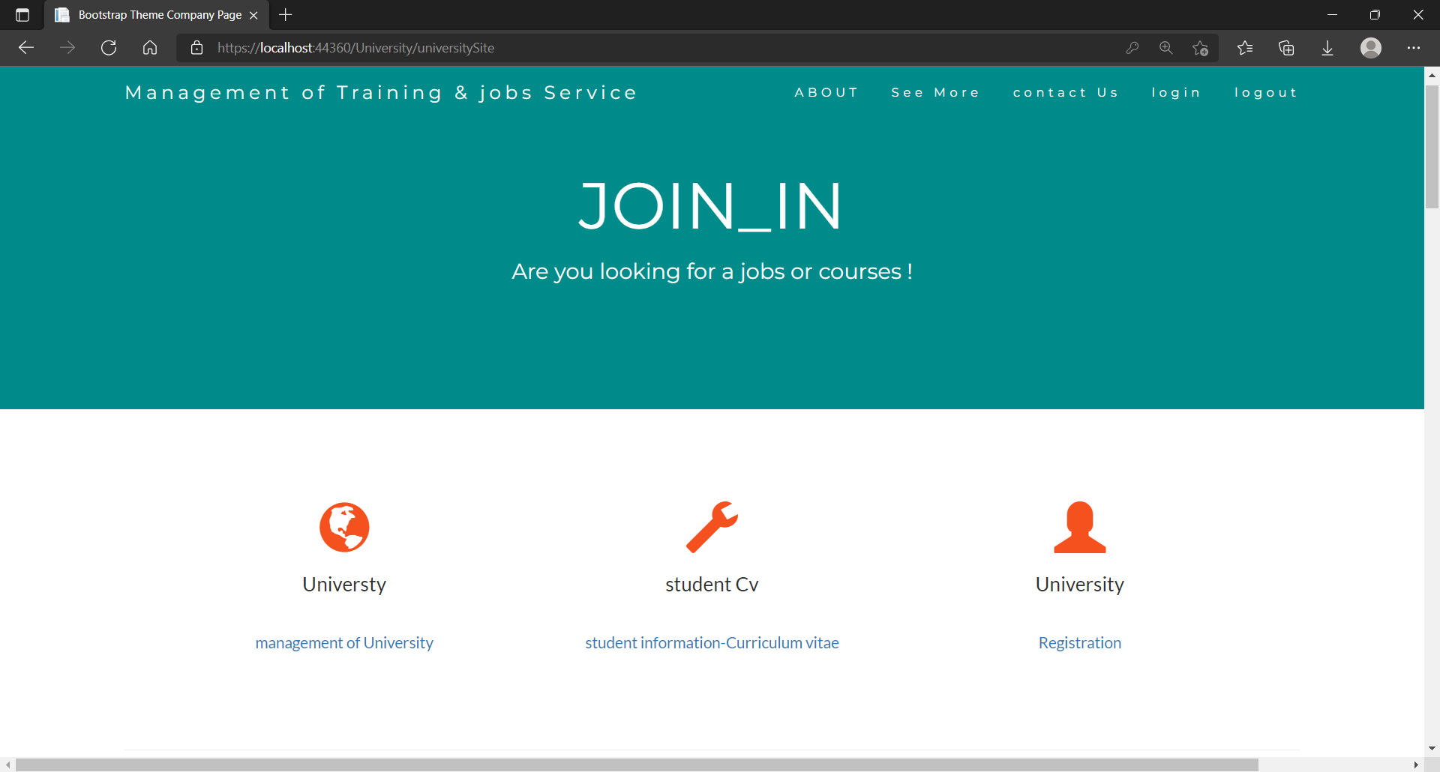
User Interface Design (University Page)

Slide 36
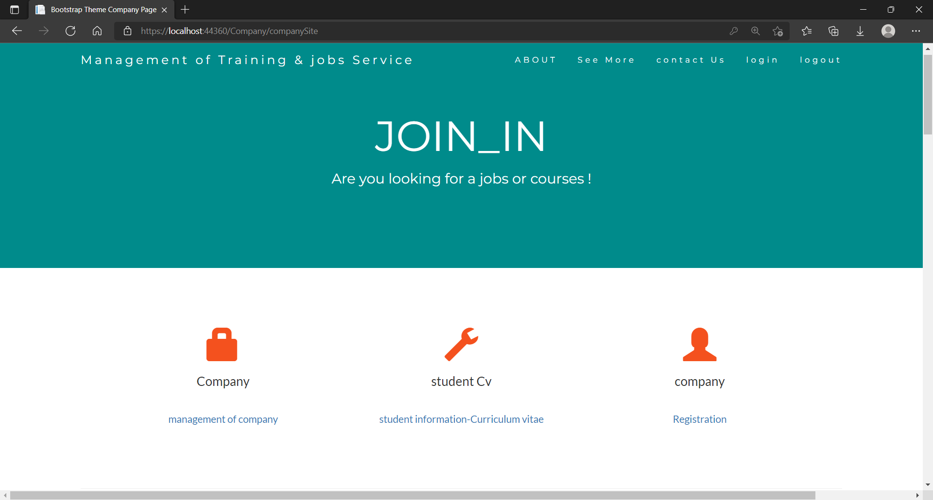
User Interface Design (Company Page)

Slide 37
System Testing
Black Box Testing
Testing by Using
Testing by Using Results

Slide 38
Black Box Testing
Test # | Description | Input | Expected Output | Pass / Fail
1 | Testing Login | Username: Ahmad Password: 2018200 | Condition (Login Successful) | Passed
2 | Testing Login | Username: Ahmad Password: 20185050 | The admin page will not open and an alert will appear | Passed

Slide 39
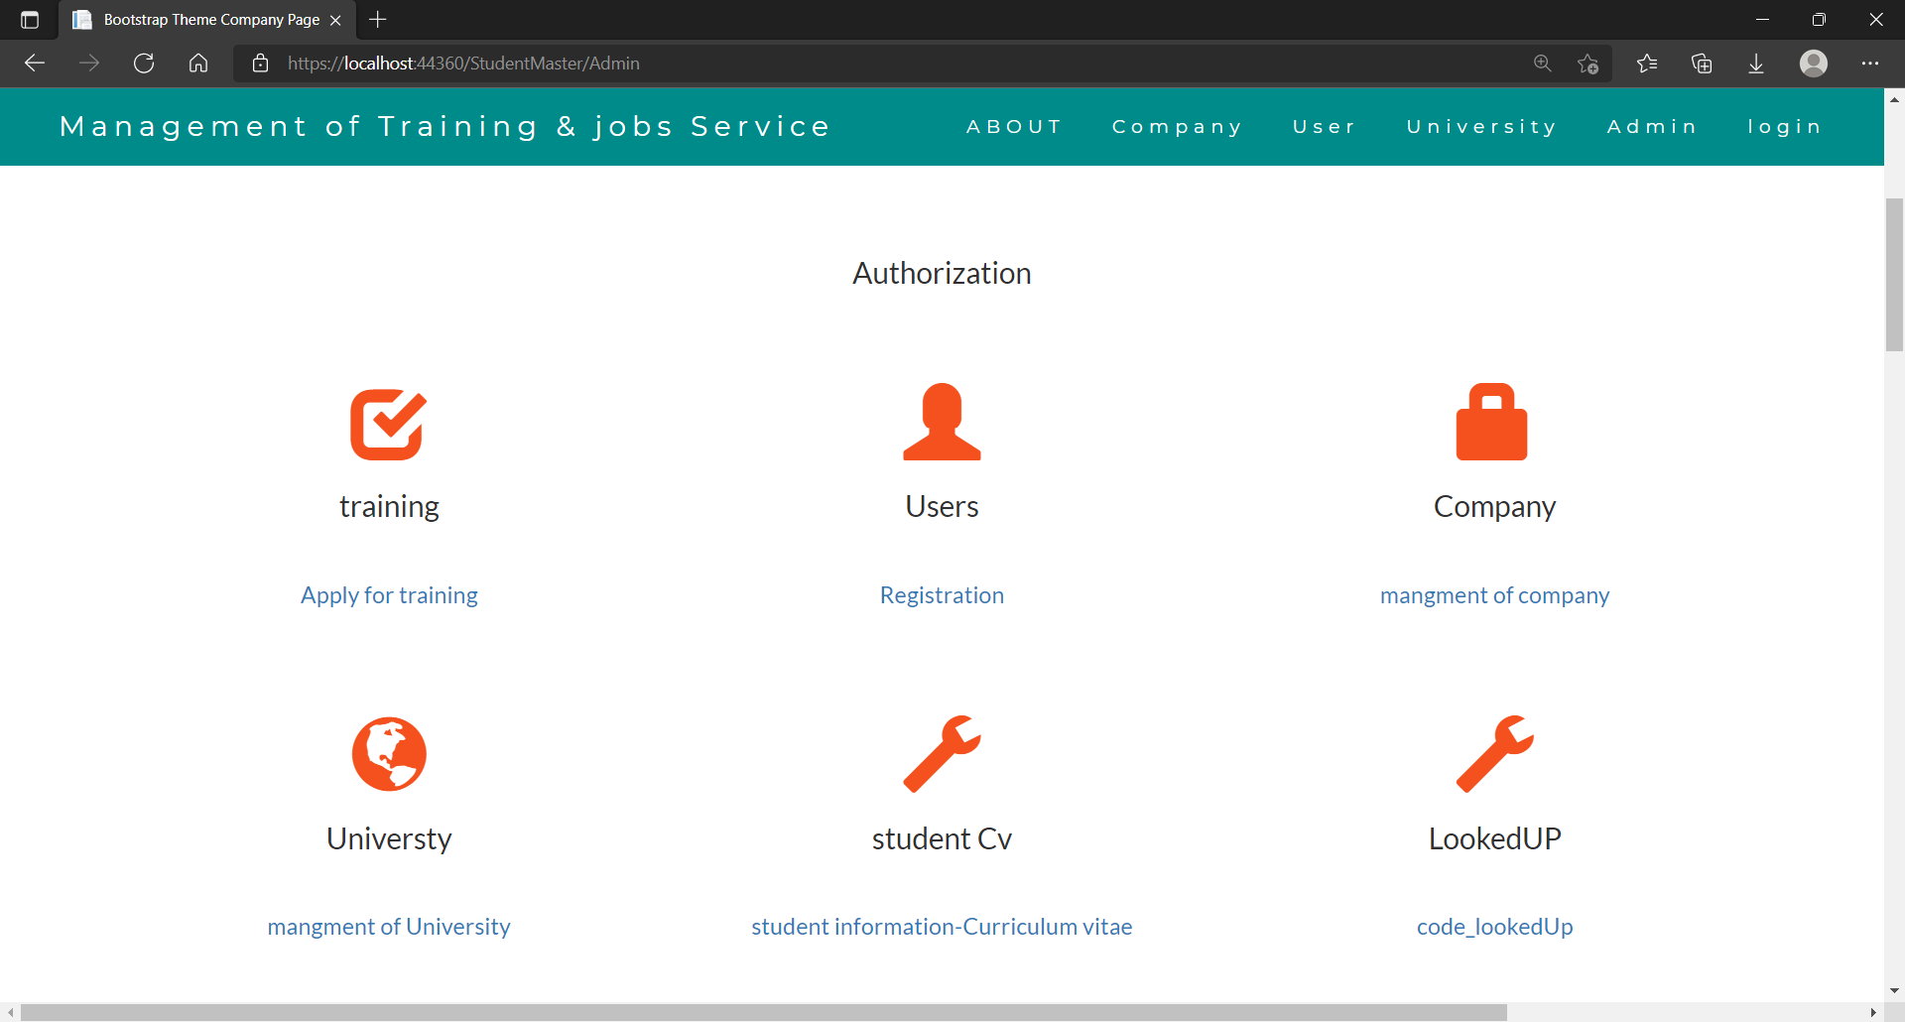
Black Box (Testing Case #1)

Slide 40
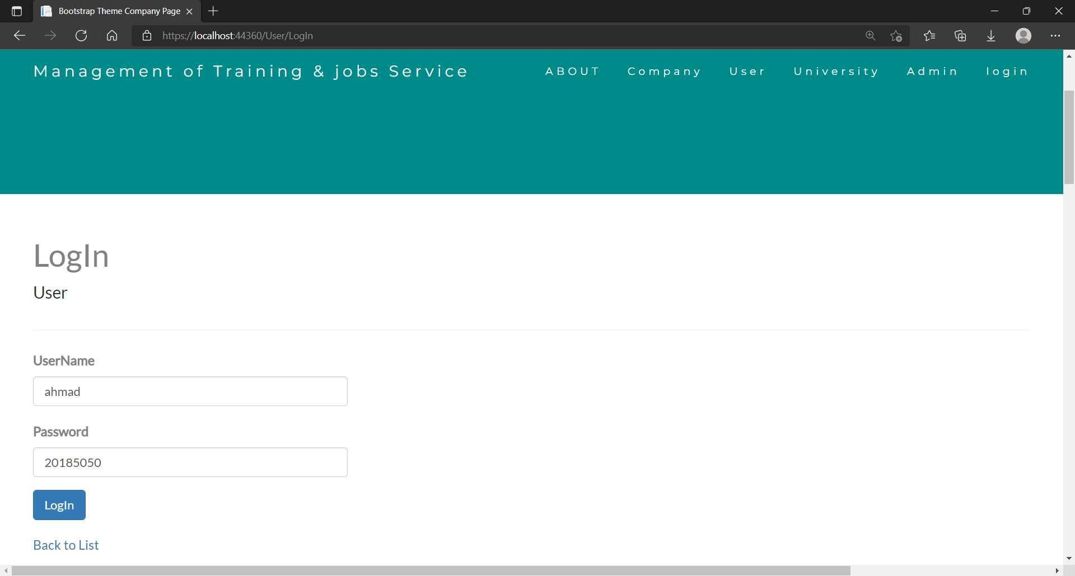
Black Box (Testing Case #2)

Slide 41
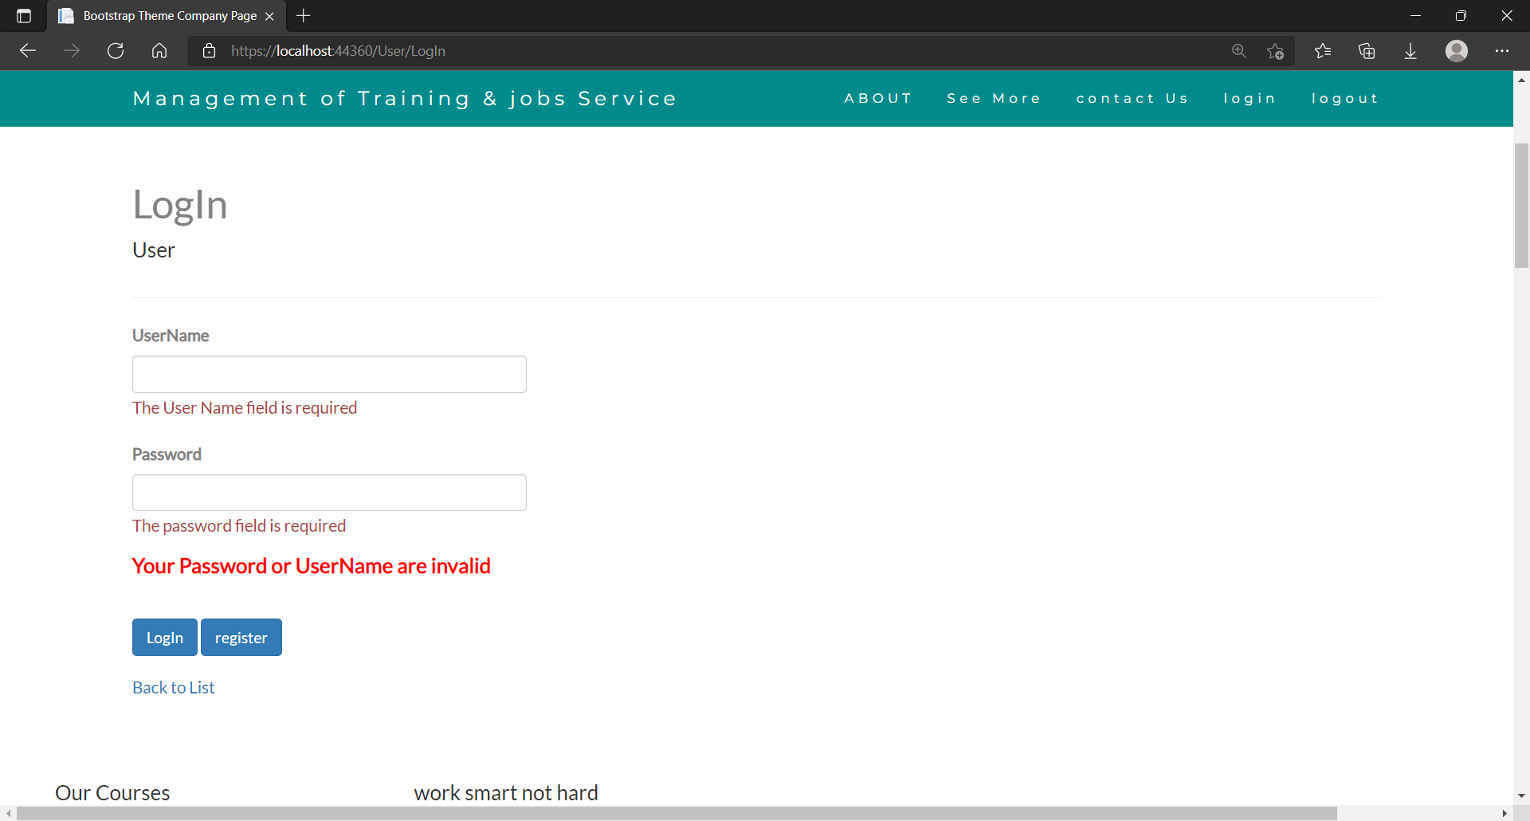
Black Box (Testing Case #3)

Slide 42
Testing by Using
Operation | Test data
Registrations | Subject: Registration Description: Creating account named : Test With password : Test12
Apply for training | Course Name: IOT(internet of things)
Print Forms or page’s | Printing a filled form or Page

Slide 43
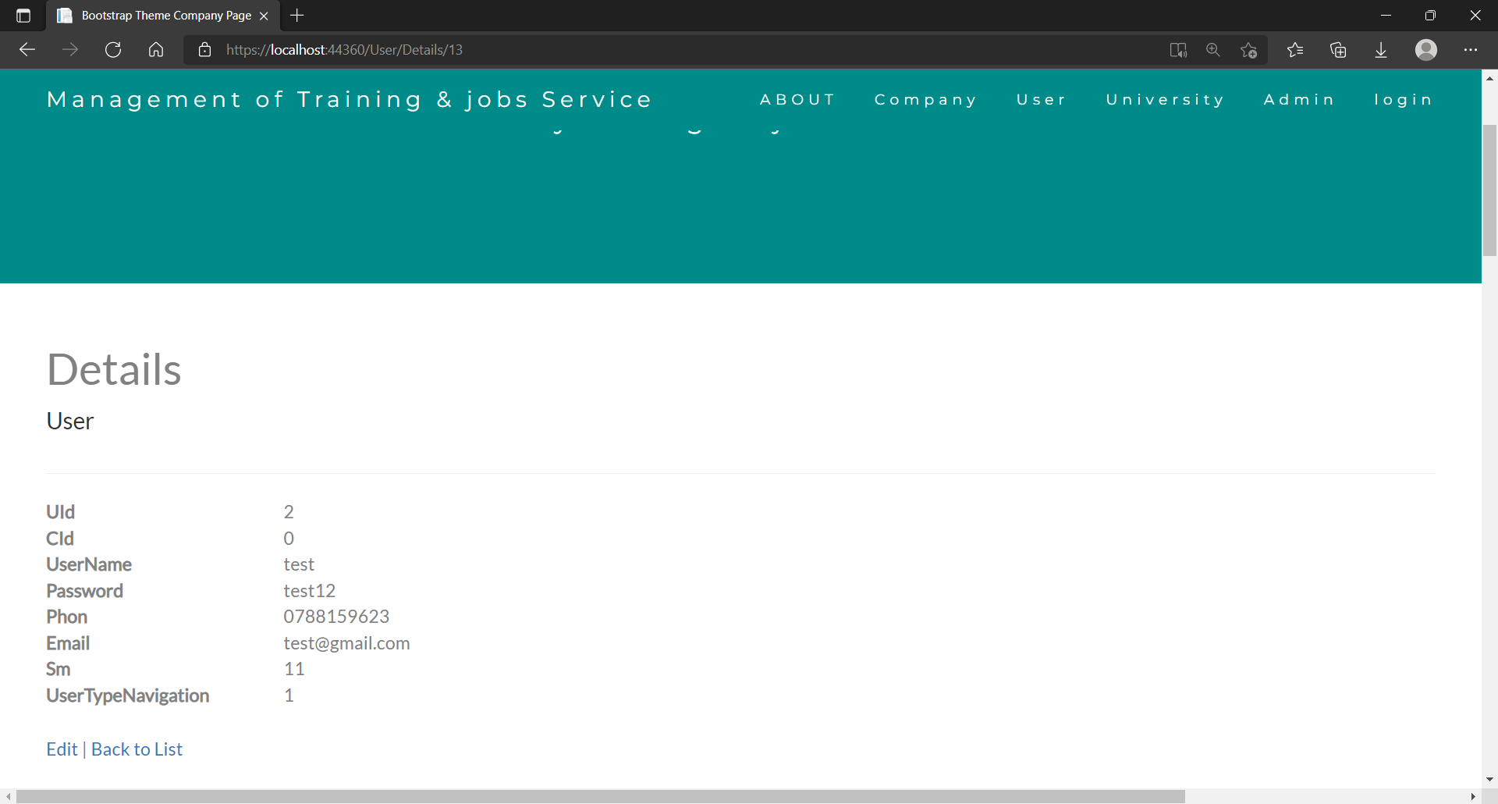
Testing by Using

Slide 44
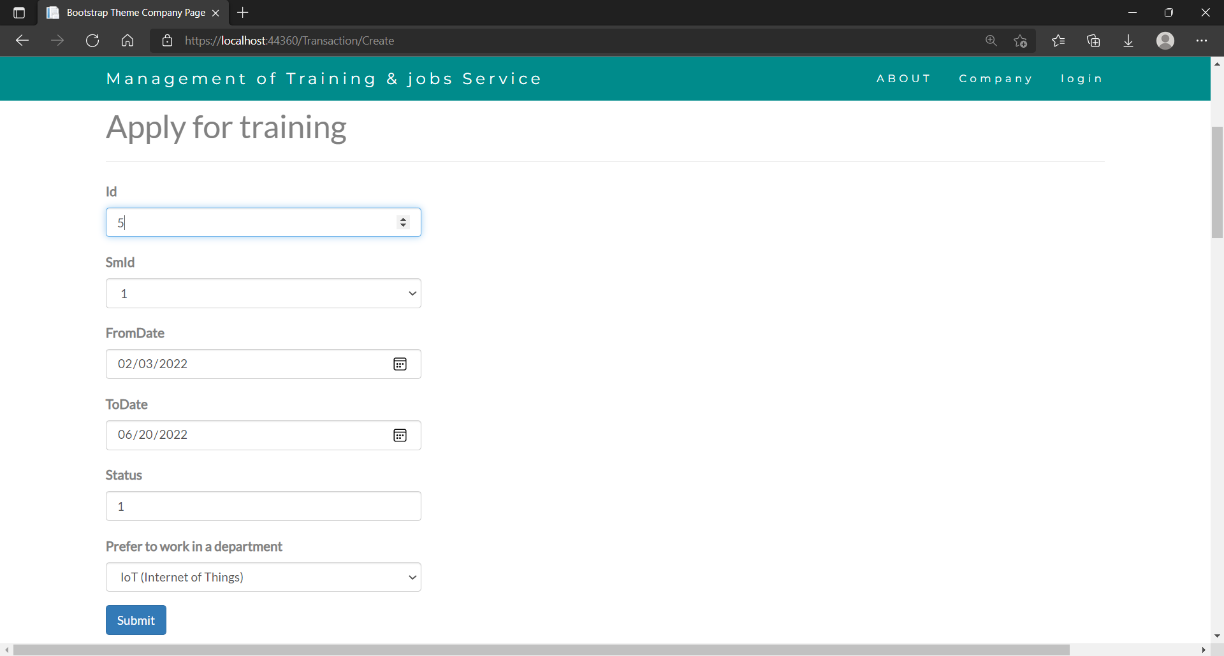
Testing by Using

Slide 45
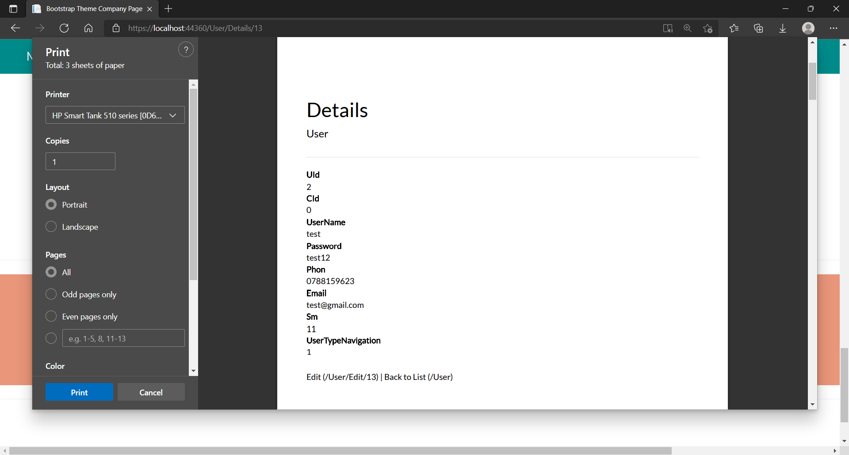
Testing by Using

Slide 46
Testing by Using Results
Operation | Result
Registration | Registration Successfully
Apply for a Course | Applied Successfully
Print a form or a page | Printed Successfully

Slide 47
Conclusion & Future work
Conclusion
Future work

Slide 48
Conclusion
Management of Training & jobs Service is an effective and useful website it’s designed to help the students to apply for the elite companies to be trained at with ease, students can also upload their CV’s for companies to view. And the student have better chance’s to get trained in the elite companies by applying through our website because universities are connected to both registered students and available companies.

Slide 49
Future work
More work could be done to change on the home design also adding more than one language to the site as well as improve the security system to make sure that all the information's on the system are safe from hacking, more portals and pages will be added to the site . Develop the site to contain job for students, also, competitions and awards to support students' CV. And to make sure that the website will be used by a lot of people we going to do a mobile applications, The Portals can also be upgraded to include a private chat system between the student and companies to insure a good communication, a page will be added that include all Books and references a student might need.

Slide 50
References
Reid Hoffman’s. “LinkedIn” Internet : https://www.linkedin.com/, May 5, 2003 [October 10th , 2021]
Refines Data. “W3Schools.” Internet: https://www.w3schools.com/, 1998.
Mark Otto, Jacob Thornton. “Bootstrap.” Internet: https://getbootstrap.com, August.19,2011.
Brendan Eich. “JavaScript” Internet: https://www.javascript.com/, December.4,1995.
John Resig, Brandon Aaron, Jörn Zaefferer. “jQuery.” Internet: https://jquery.com, August.26,2006.
Jeff Atwood, Joel Spolsky. “Stack Overflow.” Internet: https://stackoverflow.com, September.15,2008.

Slide 51
Management of Training & jobs Service
Submitted By:
Ahmad Abu ghazal- 201820056
Abdullah Majed Abughali– 201410848
Supervisor:
Dr. Muhammad Al-Tayee

